Slide 1

Data Analysis Report

Slide 2
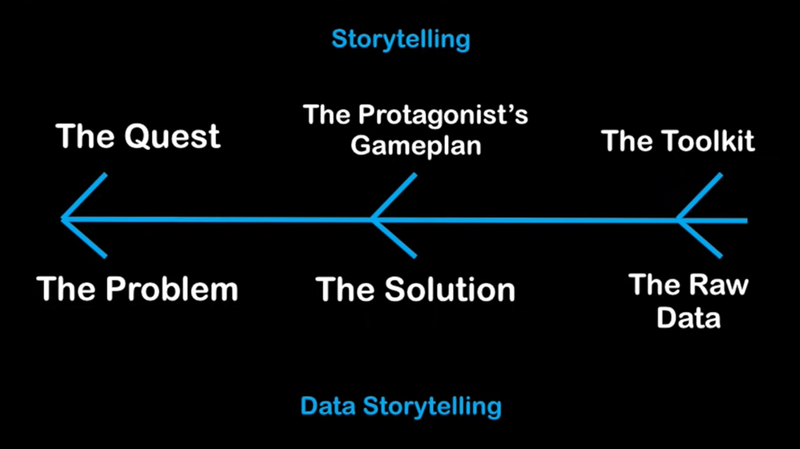

Slide 3
Our Agenda
Project recap
The Problem
The Analytics team
Process
Insights
Summary

Slide 4
Project Recap
Social Buzz is a fast growing technology unicorn that need to adapt quickly to it's global scale. Accenture has begun a 3 month POC focusing on these tasks:
An audit of Social Buzz's big data practice
Recommendations for a successful IPO
Analysis to find Social Buzz's top 5 most popular categories of content
`

Slide 5

Problem
Over 100,000 posts per day
36,500,000 pieces of Data per year!
But how to capitalize on it when there is so much Data?
Analysis to find Social Buzz's top 5 most popular categories of content

Slide 6


Data Analytics Team
ANDREW FLEMING
Chief Technology Architect
MARCUS ROMPTON
Senior Principal
Mahesh Jadhav
Data Analyst

Slide 7



Slide 8
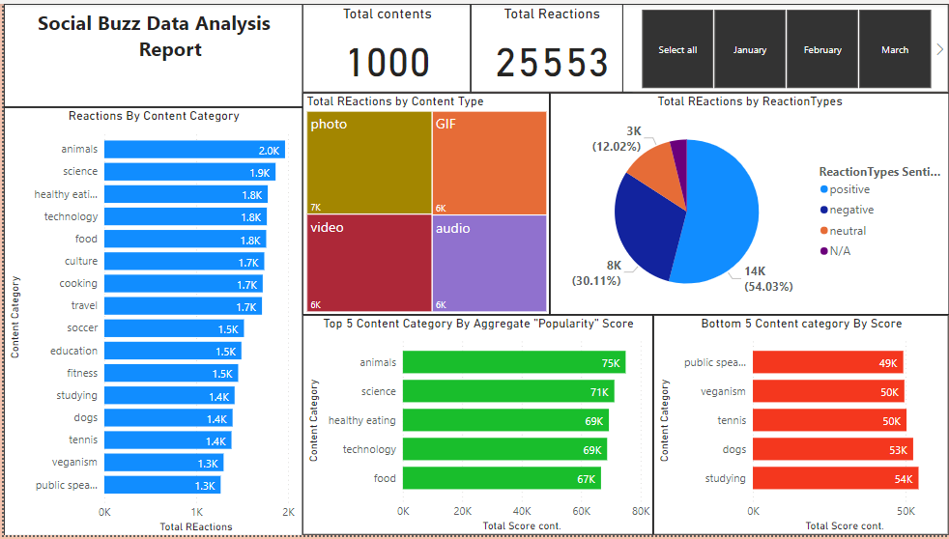

Slide 9
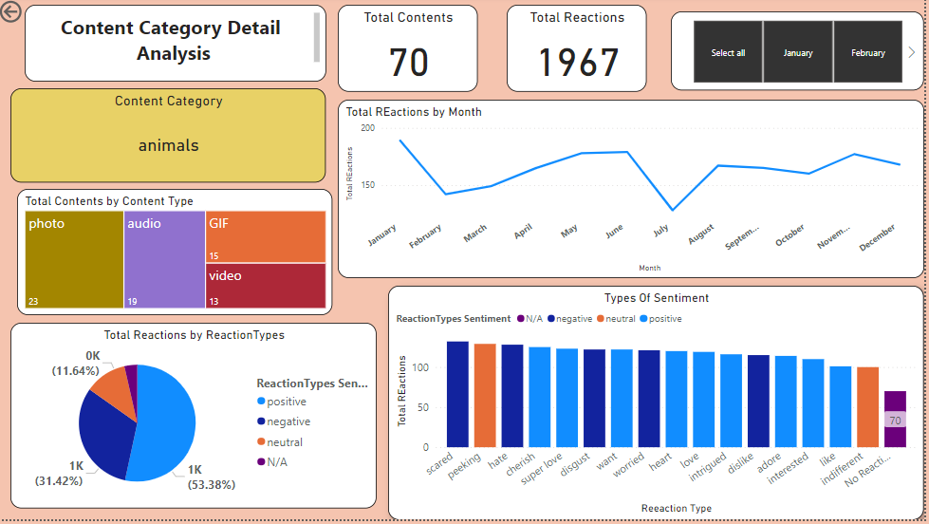

Slide 10

Key Insights
16
1967
JANUARY
UNIQUE
CATEGORIES
REACTIONS TO
"ANIMAL" POSTS
MONTH WITH
MOST POSTS

Slide 11
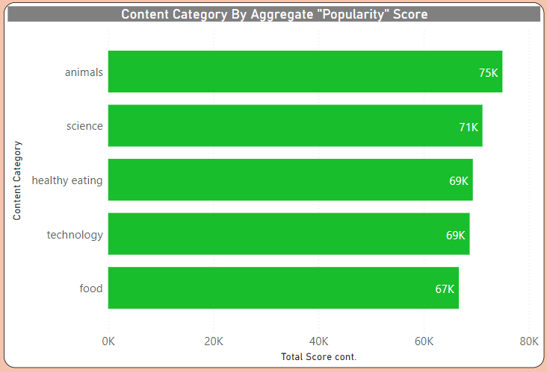

Slide 12
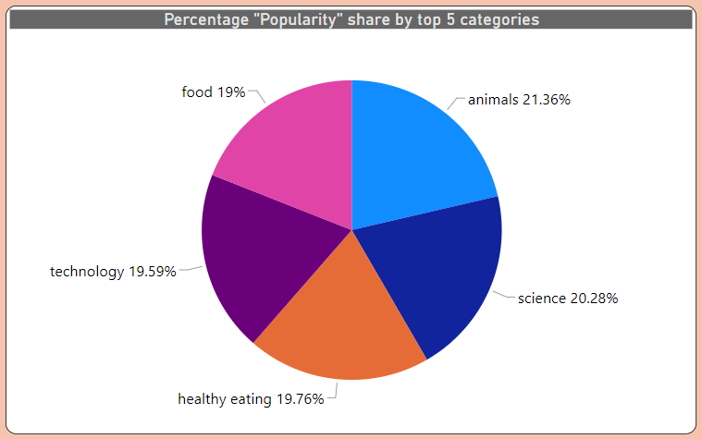

Slide 13

ANALYSIS
Animals and science are the two most popular categories of content, showing that people enjoy "real-life" and "factual" content the most.
Summary
INSIGHT
Food is a common theme with the top 5 categories with "Healthy Eating" ranking the highest. This may give an indication to the audience within your user base. You could use this insight to create a campaign and work with healthy eating brands to boost user engagement.
NEXT STEPS
This ad-hoc analysis is insightful, but it's time to take this analysis into large scale production for real-time understanding of your business. We can show you how to do this.

Slide 14
Thank you!

